Slide 2
Oracle and kafka
On premises
Service Bus Kafka transport (demo!)
Stream Analytics Kafka Adapter (demo!)
GoldenGate for Big Data handler for Kafka
Data Integrator (coming soon)
Cloud
Elastic Big Data & Streaming platform
Event Hub (coming soon)

Slide 3
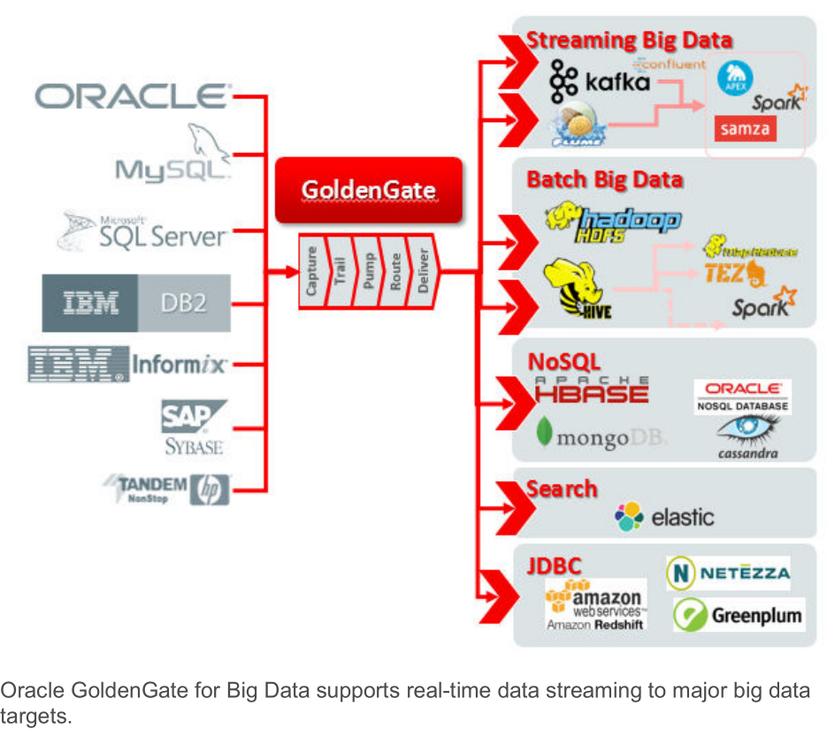
GoldenGate for Big Data

Slide 4
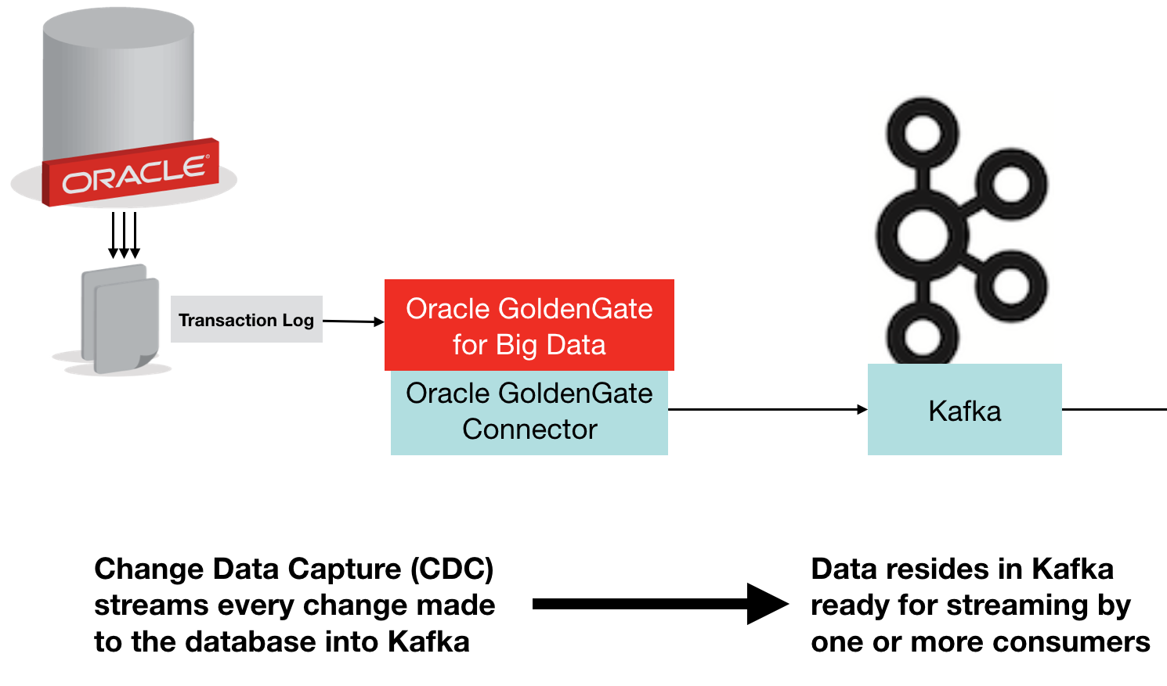
GoldenGate for Big Data

Slide 5
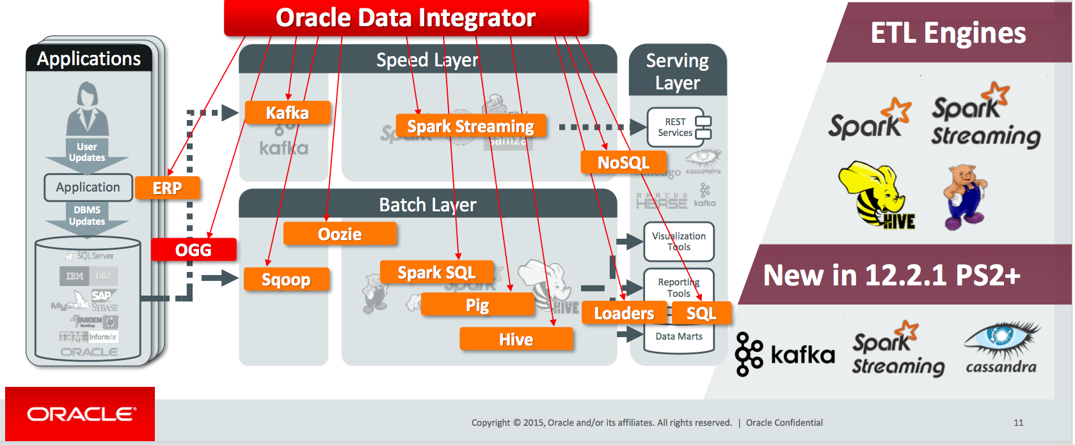
Data Integrator

Slide 6
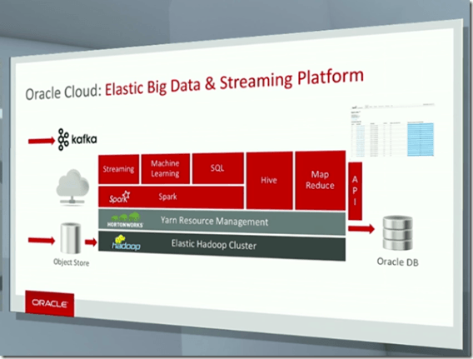
Elastic Big Data & Streaming platform

Slide 7
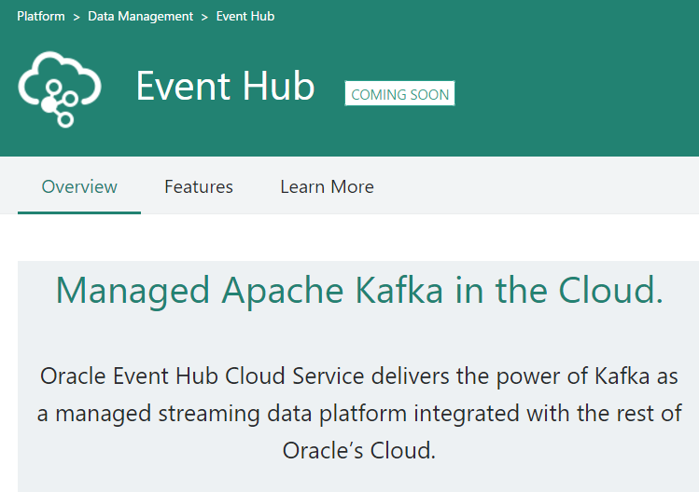
Event Hub

Slide 8
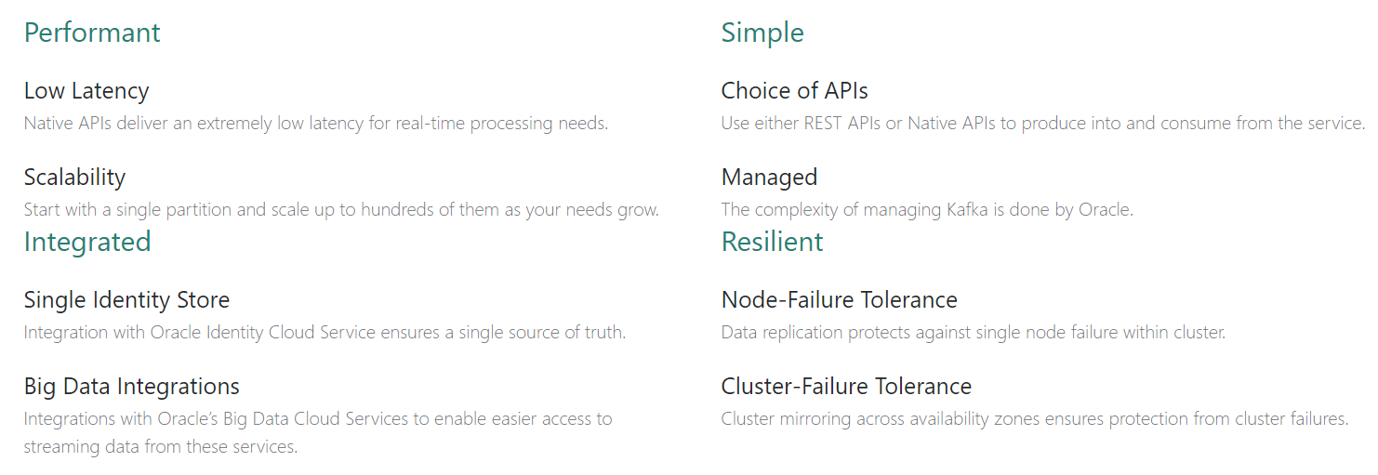
Event Hub

Slide 9
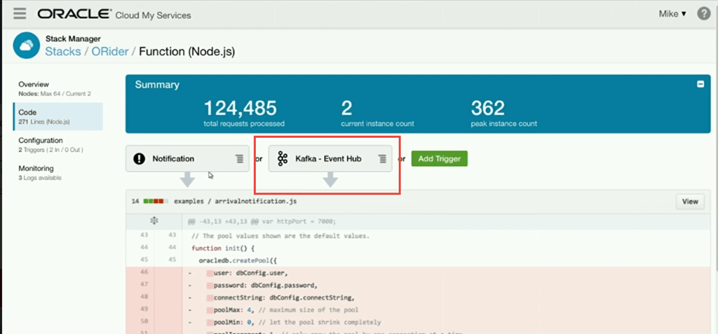
EVENT hub

